Slide 1
Quantifying Demand
RSM 5010

Slide 2
Where we are, where we’re going
Deeper dive into quantifying demand
Relevant to industry demand and the supply and demand model: is demand steep or flat?
But also relevant to firm demand: how does demand influence pricing

Slide 3
Overview
Questions:
How sensitive is demand to price?
How important is the pricing of competing products?
Concepts:
Demand functions (from last time, but with equations)
Demand elasticity
Economic principles:
Sometimes reducing price attracts many more customers, sometimes only very few

Slide 4
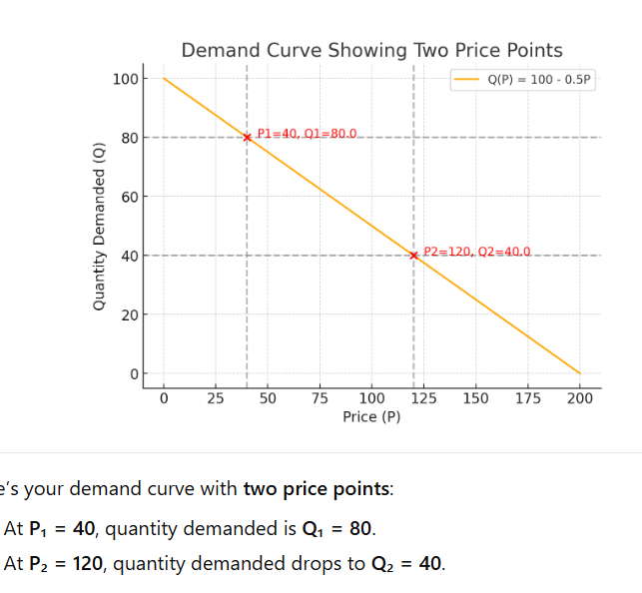
Demand functions
A demand function Q(P) describes the relationship between price and quantity demanded (when all other factors are held constant):
e.g., Q(P) = 100 – 0.5P.
Demand curve is simply the graphical representation.
Law of demand: Q(P) is a decreasing function of P.
In general, the quantity Q demanded at price P also depends on many other factors
Notes:
Law of demand: Q(P) is a decreasing function of P
it means: As price (P) increases → people buy less → quantity demanded (Q) goes down.
💡 Easy way to think about it:
Imagine your favorite coffee:
At $3, you might buy it every day.
At $6, maybe only twice a week.
At $10, probably never.
So, as price goes up, demand goes down — that’s why it’s a decreasing function.
🧠 In simple math terms:
If the demand function is Q(P) = 100 − 0.5P,
when P = 0 → Q = 100 (everyone wants it!)
when P = 100 → Q = 50
when P = 200 → Q = 0
The slope is negative (−0.5), showing that for every $1 increase in price, 0.5 fewer units are demanded.
👉 In short: higher prices discourage buyers — that’s the law of demand.

Slide 5

Coke and Pepsi example
The demand for Coke and Pepsi:
Estimated demands based on quarterly data from 1968 to 1986:
Q – quarterly quantity of syrup sold
P – price of syrup (1986 dollars)
A – square root of quarterly advertising expenses (1986 dollars)
S – equals 1 if spring or summer, equals 0 if winter or fall
I – real income (1986 dollars)
Average values from data: Q_{C} = 30.22, Q_{P} = 22.72 , P_{C} = 12.96, P_{P} = 8.16, A_{C} = 5.89,
A_{P} = 5.28, I = 20.63 (The difference in prices reflects, among other things, different syrup concentration).
Source: Gamsi, Laffont, and Vuong, “Econometric Analysis of Collusive Behavior in a Soft-Drink Market,” Journal of Economics and Management Strategy, Summer 1992.
Notes:
QC​=26.17−3.98PC​+2.25PP​+…
Here, the coefficient of $P_{C}$is −3.98. That means Coke’s own price ($P_{C}$) affects quantity demanded ($Q_{C}$) negatively.
What it means in plain English:
The formula says:
For every 1 unit increase in Coke’s price, the quantity demanded of Coke goes down by 3.98 units.
That’s because:
$$ΔQ_{C}=−3.98×ΔP_{C}$$
So:
If $P_{C}$goes up, $Q_{C}$goes down.
If $P_{C}$goes down, $Q_{C}$goes up.
That’s exactly the Law of Demand — just written in math form. The negative sign (−3.98) doesn’t mean the price itself is negative — it means the relationship between price and demand is inverse.
🎯 In short:
$P_{C}$= Coke’s price
Coefficient (−3.98) = slope showing direction of effect
Negative slope → when price rises, demand falls
So yes — the minus sign confirms that Coke’s demand decreases when Coke’s price increases.

Slide 6
Demand elasticity
How sensitive is demand to price, consumer income, or the prices of competing products?
If I increase my price by 2% next month, how will that affect demand for my product?
If my rival lowers its price by 5% next year, how will that affect demand for my product?
Demand elasticity is a concept developed to help answer this type of question…
Price elasticity of demand
Income elasticity of demand
Cross-price elasticity of demand

Slide 7
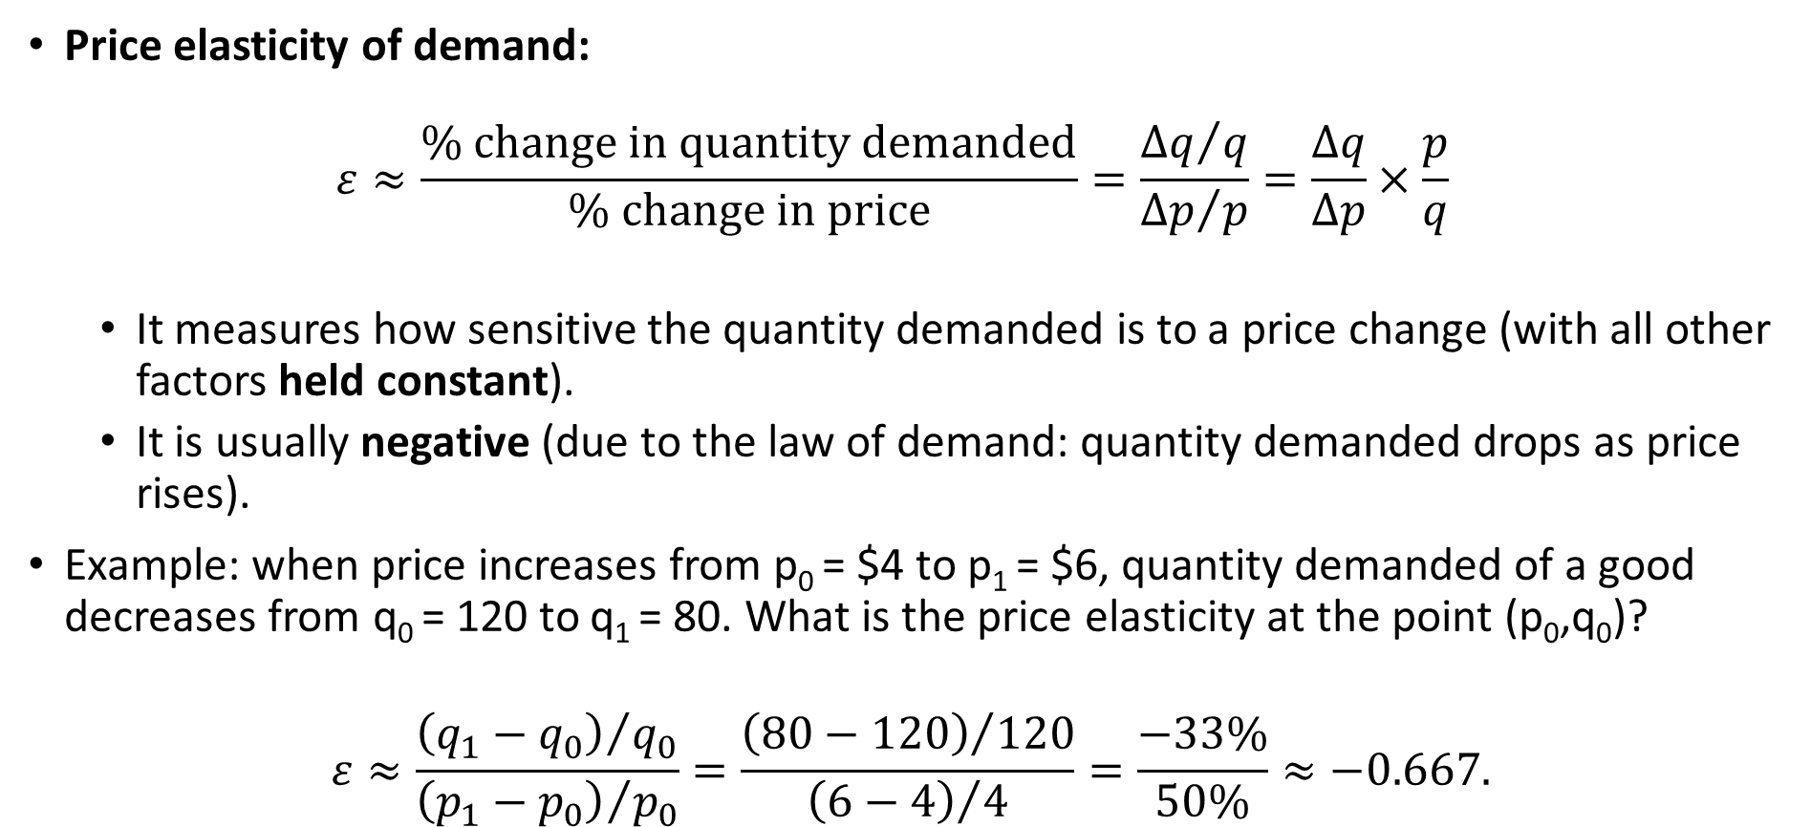
Price elasticity of demand
Price elasticity of demand: $ε≈\frac{\% change in quantity demanded}{\% change in price}=\frac{{Δq}/q}{{Δp}/p}=\frac{Δq}{Δp}×\frac{p}{q}$
It measures how sensitive the quantity demanded is to a price change (with all other factors held constant).
It is usually negative (due to the law of demand: quantity demanded drops as price rises).
Example: when price increases from p₀ = $4 to p₁ = $6, quantity demanded of a good decreases from q₀ = 120 to q₁ = 80. What is the price elasticity at the point (p₀,q₀)?
$$ε≈\frac{{\left(q_{1}−q_{0}\right)}/{q_{0}}}{{\left(p_{1}−p_{0}\right)}/{p_{0}}}=\frac{{\left(80−120\right)}/{120}}{{\left(6−4\right)}/4}=\frac{−33\%}{50\%}≈−0.667.$$

Slide 8
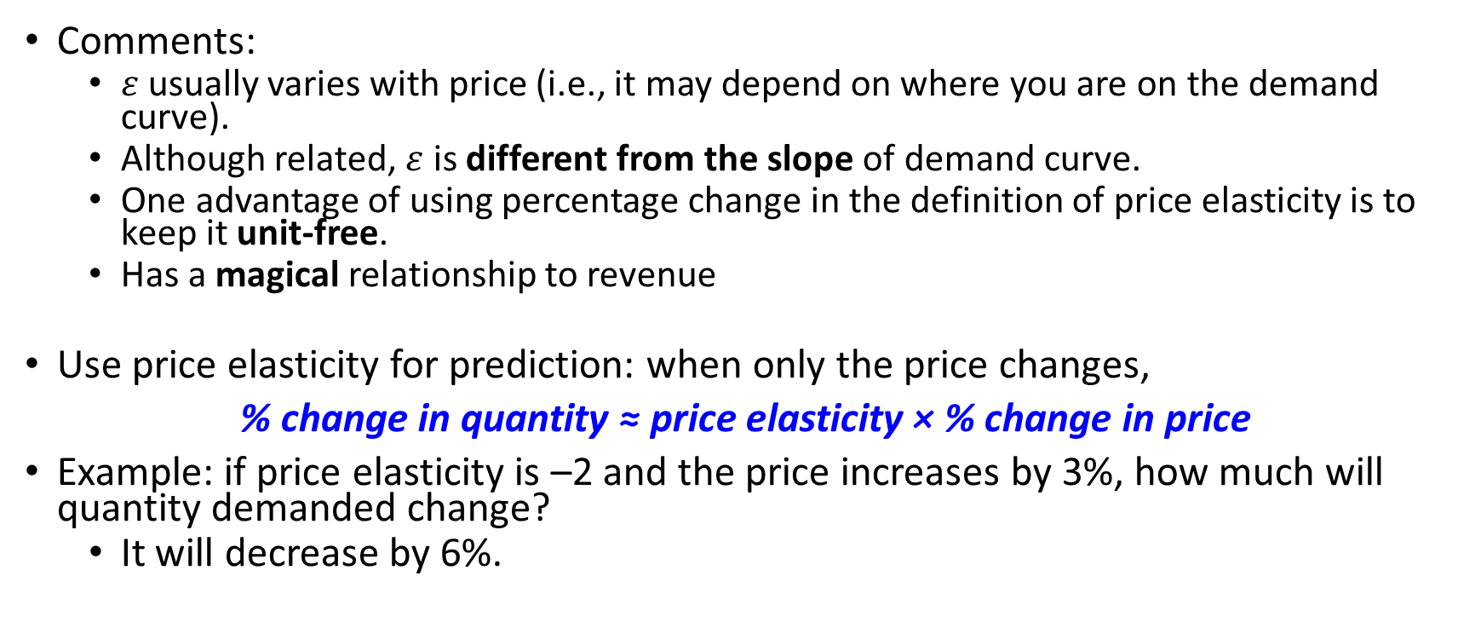
Price elasticity of demand
Comments:
$ε$ usually varies with price (i.e., it may depend on where you are on the demand curve).
Although related, $ε$ is different from the slope of demand curve.
One advantage of using percentage change in the definition of price elasticity is to keep it unit-free.
Has a magical relationship to revenue
Use price elasticity for prediction: when only the price changes,
% change in quantity ≈ price elasticity × % change in price
Example: if price elasticity is –2 and the price increases by 3%, how much will quantity demanded change?
It will decrease by 6%.

Slide 9
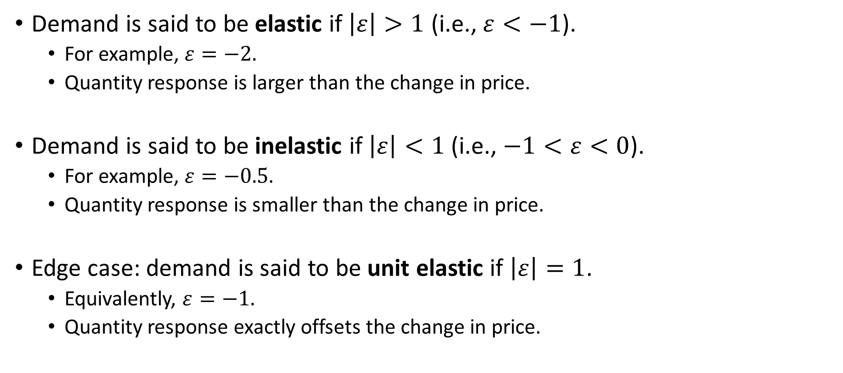
Price elasticity of demand
Demand is said to be elastic if $\left|ε\right|>1$ (i.e., $ε<−1$).
For example, $ε=−2.$
Quantity response is larger than the change in price.
Demand is said to be inelastic if $\left|ε\right|<1$ (i.e., $−1<ε<0$).
For example, $ε=−0.5.$
Quantity response is smaller than the change in price.
Edge case: demand is said to be unit elastic if $\left|ε\right|=1$.
Equivalently, $ε=−1.$
Quantity response exactly offsets the change in price.

Slide 10
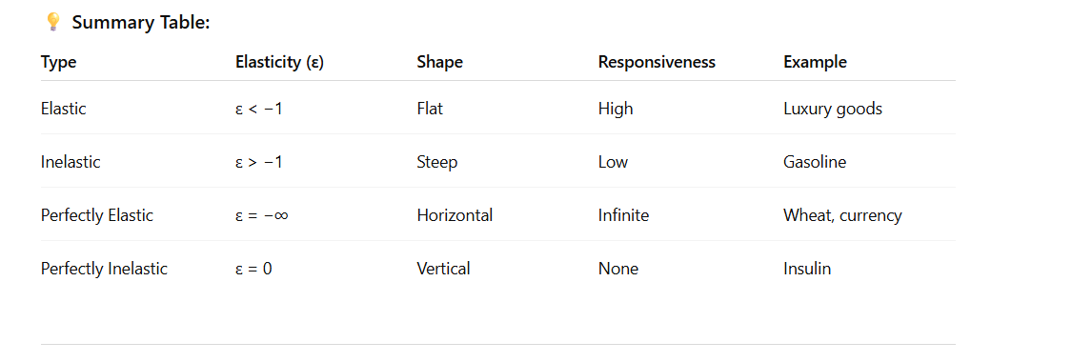


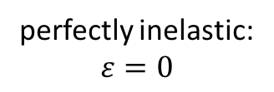
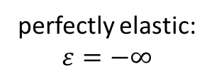
Price elasticity and demand curves
P
P
elastic: $ε<−1$
inelastic: $ε>−1$
6
6
4
4
40
90
Q
60
72
Q
P
P
perfectly elastic:
$$ε=−∞$$
perfectly inelastic:
$$ε=0$$
Q
Q
Notes:
Top-left: Elastic demand (ε < −1)
What it shows: The demand curve is relatively flat. When price changes slightly, quantity demanded changes a lot.
Example: Luxury goods, branded clothes, vacations.
Explanation: Consumers are very responsive to price changes. If the price falls from 6 to 4, quantity demanded jumps sharply (40 → 90).
Key takeaway: A small drop in price → big increase in demand → elastic response.
2️⃣ Top-right: Inelastic demand (ε > −1)
What it shows: The demand curve is steeper. When price changes, quantity demanded changes a little.
Example: Gasoline, insulin, salt.
Explanation: Even if the price rises from 4 to 6, quantity demanded only falls slightly (72 → 60).
Key takeaway: Consumers are not very responsive → inelastic demand.
3️⃣ Bottom-left: Perfectly elastic (ε = −∞)
What it shows: A horizontal line. At this price, consumers will buy any quantity. If price rises even slightly, demand drops to zero.
Example: Perfectly competitive markets (e.g., wheat, stock prices).
Key takeaway: Price is fixed by the market — firms are price takers.
4️⃣ Bottom-right: Perfectly inelastic (ε = 0)
What it shows: A vertical line. Quantity demanded never changes, no matter what happens to price.
Example: Life-saving medicine, emergency necessities.
Key takeaway: People buy the same amount even if price doubles — no price sensitivity.

Slide 11
Practice: Computing Elasticity When Slope is Constant
Demand: Q = 1000(12 – p)
Graph: Elasticity:
p₀ = 8
p₁ = 8.04
Q₀ = 4000
Q₁ = 1000(12-8.04)
= 3960
ΔQ/ Q₀ = -40/4000 = -1%
Δp/ p₀ = 0.04/8 = 0.5%
Elasticity = -1/0.5 = - 2
P
12
8
Q
12,000
4000

Slide 12
Why isn’t Elasticity constant when slope is?
Always true: if slope is constant (demand is a straight line), elasticity isn’t!
Up here, one unit of Q is a big percent change (Q is small), but one unit of P is a pretty small change (P is big) (so elasticity is far from zero; numerator big and denominator small)
P
12
Down here, the reverse, so elasticity is closer to zero
Q
12,000
Notes:
Excellent question — and this slide explains one of the trickiest yet most important ideas in microeconomics:
Even when the demand curve has a constant slope (a straight line), elasticity changes along the curve. Let’s break it down simply 👇
💡 Key Idea
Slope ≠ Elasticity
Slope measures absolute change → ΔP / ΔQ
Elasticity measures percentage change → (%ΔQ / %ΔP) → mathematically: ε = (ΔQ / ΔP) × (P / Q)
That last part (P / Q) is why elasticity changes — even if ΔQ / ΔP (the slope) is constant, the ratio P/Q changes as you move along the demand curve.
At the top of a demand curve, price (P) is high and quantity (Q) is low.
Now imagine you move slightly along the curve — say price drops a bit, and quantity rises a bit. Even though the actual (absolute) change in Q is small, it’s a big change in percentage terms, because Q itself started small.
🔹 Example:
Let’s say at the top of the curve:
Price (P) = $12
Quantity (Q) = 10 units
Now price drops to $11, and quantity rises to 15.
Change in price = 1 → %ΔP = (1 / 12) × 100 = 8.3%
Change in quantity = 5 → %ΔQ = (5 / 10) × 100 = 50%
So even though both changed by small absolute numbers (1 and 5), the percent change in Q (50%) is much larger than that of P (8.3%).
That’s what the sentence means:
“A small change in Q is a big percent change, while a change in P is a small percent change.”
🔹 Why it matters:
Elasticity = %ΔQ / %ΔP = (50%) / (8.3%) ≈ 6.0 → Highly elastic
Consumers are very responsive to price changes here — small price drop → big % change in demand.
🔹 Contrast it with the bottom of the curve:
At the bottom, say:
Price = $2
Quantity = 10,000
If price falls by $1 to $1 and quantity rises by 500:
%ΔP = (1 / 2) × 100 = 50%
%ΔQ = (500 / 10,000) × 100 = 5%
Now elasticity = 5% / 50% = 0.1 (inelastic)
✅ In short: When quantity is small (top of curve), small numerical changes are large in percentage terms, making demand elastic. When quantity is large (bottom of curve), small numerical changes are tiny in percentage terms, making demand inelastic.
🎯 Situation: Bottom of the demand curve
At this point:
Price (P) is low
Quantity (Q) is high
That means consumers are already buying a lot, so an extra few units don’t make much difference percentage-wise.
💡 Formula for elasticity:
$$E=\frac{\%ΔQ}{\%ΔP}=\frac{\left(ΔQ/Q\right)}{\left(ΔP/P\right)}=\frac{ΔQ}{ΔP}×\frac{P}{Q}$$
Here, $ΔQ/ΔP$(the slope part) is constant, but $P/Q$changes — that’s why elasticity varies along the curve.
🧮 Example Calculation (Bottom of Curve)
Let’s say at the bottom:
$P_{1}=2$, $Q_{1}=10,000$
$P_{2}=1.8$, $Q_{2}=10,200$
Now compute step by step:
Step 1: Find % change in quantity
$$\%ΔQ=\frac{\left(10,200−10,000\right)}{10,000}×100=\frac{200}{10,000}×100=2\%$$
Step 2: Find % change in price
$$\%ΔP=\frac{\left(1.8−2\right)}{2}×100=\frac{−0.2}{2}×100=−10\%$$
Step 3: Elasticity
$$E=\frac{\%ΔQ}{\%ΔP}=\frac{2\%}{−10\%}=−0.2$$
🧩 Interpretation:
$∣E∣=0.2<1$→ Inelastic demand
Meaning: A 10% drop in price causes only a 2% rise in quantity.
So, even though quantity increased by 200 units, compared to 10,000 total units, that’s a tiny percentage change.
Hence:
“When quantity is large (bottom of curve), small numerical changes are tiny in percentage terms — making demand inelastic.”
💭 Quick contrast (top of curve): If $Q$were 100 instead of 10,000, and $ΔQ=200$, then $\%ΔQ=200/100×100=200\%$! → Elastic.
So the math logic is:
Same numerical ΔQ = 200, but when Q = 10,000 → 2% change (inelastic), when Q = 100 → 200% change (elastic).

Slide 13
Elasticity, Total Revenue and Linear Demand
P
TR
100
0
10
20
30
40
50
Q
0
Q

Slide 14
Elasticity, Total Revenue and Linear Demand
P
TR
100
80
800
0
10
20
30
40
50
Q
0
10
20
30
40
50
Q

Slide 15
Elasticity, Total Revenue and Linear Demand
P
TR
100
80
60
1200
800
0
10
20
30
40
50
Q
0
10
20
30
40
50
Q

Slide 16
Elasticity, Total Revenue and Linear Demand
P
TR
100
80
60
1200
40
800
0
10
20
30
40
50
Q
0
10
20
30
40
50
Q
Notes:
left graph (Demand curve):
The red line is a linear demand curve — showing how Price (P) falls as Quantity (Q) increases.
As price drops from 100 → 40, quantity demanded rises from 0 → 30. That’s the classic downward slope.
Right graph (Total Revenue, TR):
Total Revenue (TR) = Price × Quantity $$TR=P×Q$$
Each black dot on the right corresponds to one (P, Q) point on the left.
📈 How TR Is Related to P and Q
When P is very high, Q is small, so $TR=P×Q$is small. (e.g. at P = 100, Q ≈ 0 → TR ≈ 0)
As P falls, Q rises, and TR initially increases because the extra quantity sold outweighs the lower price. (from 80×10 = 800 → 60×20 = 1200)
But as P keeps falling, TR eventually decreases because price drops faster than quantity grows. (40×30 = 1200 — same TR, then falls afterward)

Slide 17
Elasticity, Total Revenue and Linear Demand
P
TR
100
80
60
1200
40
20
800
0
10
20
30
40
50
Q
0
10
20
30
40
50
Q

Slide 18
Elasticity, Total Revenue and Linear Demand
P
TR
100
Elastic
80
60
1200
40
20
800
0
10
20
30
40
50
Q
0
10
20
30
40
50
Q
Elastic
Notes:
Think of elasticity like a rubber band:
When it stretches a lot (elastic), revenue grows with movement.
When it barely stretches (inelastic), revenue shrinks if you push it further.
The midpoint is the “just right” stretch — perfect tension for maximum TR.
1. Elastic Region (High Price, Low Quantity)
You’re selling few units, but at a high price.
If you lower the price a little, many more people start buying → big jump in Q.
Because Q increases faster than P drops, TR (P×Q) increases. ✅ So: When demand is elastic → Price ↓ ⇒ TR ↑
Example: Movie ticket at $20 → 10 people buy (TR = 200) Drop to $15 → 20 people buy (TR = 300) → TR went up!
2. Unit Elastic Point (Midpoint of Demand Curve)
Here elasticity = 1.
The % change in Q exactly offsets the % change in P.
So TR is at its maximum — you can’t increase it further. 💡 Think of it as the “sweet spot.”
At this midpoint: Small price cuts don’t change TR at all — revenue is stable.
3. Inelastic Region (Low Price, High Quantity)
You’re selling a lot, but at a very low price.
If you cut price further, you barely gain more customers — people are already buying.
Price falls faster than Q rises, so TR decreases. ❌ So: When demand is inelastic → Price ↓ ⇒ TR ↓
Example: Ticket at $10 → 40 buyers (TR = 400) Drop to $5 → 50 buyers (TR = 250) → TR went down!
📊 Visual Intuition
Top of the curve → elastic → TR rising.
Middle → unit elastic → TR highest.
Bottom → inelastic → TR falling.

Slide 19
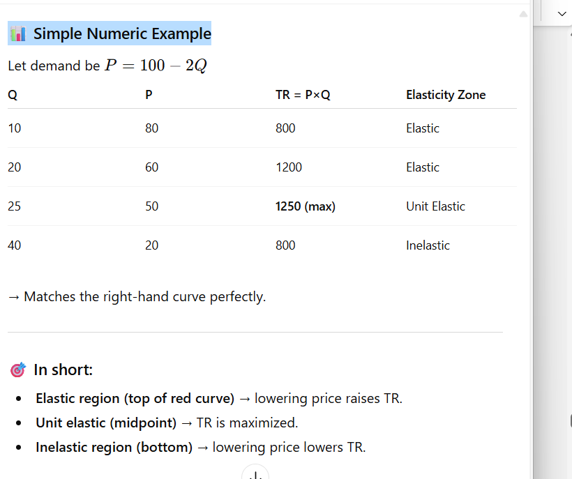
Elasticity, Total Revenue and Linear Demand
P
TR
100
Elastic
80
60
1200
Inelastic
40
20
800
0
10
20
30
40
50
Q
0
10
20
30
40
50
Q
Elastic
Inelastic

Slide 20
Elasticity, Total Revenue and Linear Demand
P
TR
100
Elastic
Unit elastic
80
Unit elastic
60
1200
Inelastic
40
20
800
0
10
20
30
40
50
Q
0
10
20
30
40
50
Q
Elastic
Inelastic

Slide 21
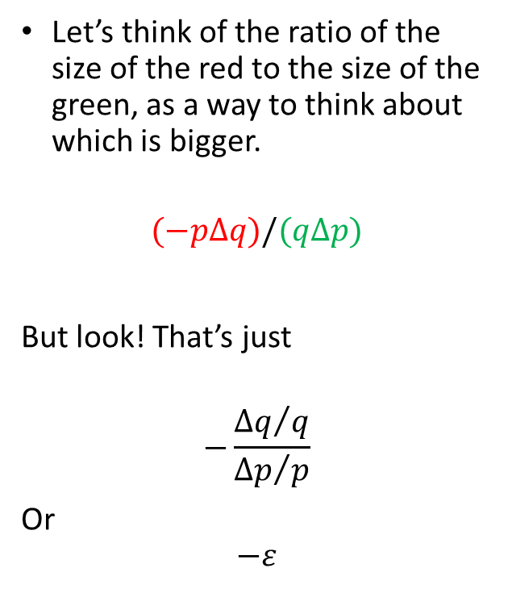
Price elasticity and revenue: Graphical “proof”
Let’s think of the ratio of the size of the red to the size of the green, as a way to think about which is bigger.
$$(−pΔq)/(qΔp)$$
But look! That’s just
$$−\frac{{Δq}/q}{{Δp}/p}$$
Or
$$−ε$$
revenue gained ≈ q∆p > 0
p+∆p
revenue lost ≈ p∆q < 0
p
q+∆q
q

Slide 22
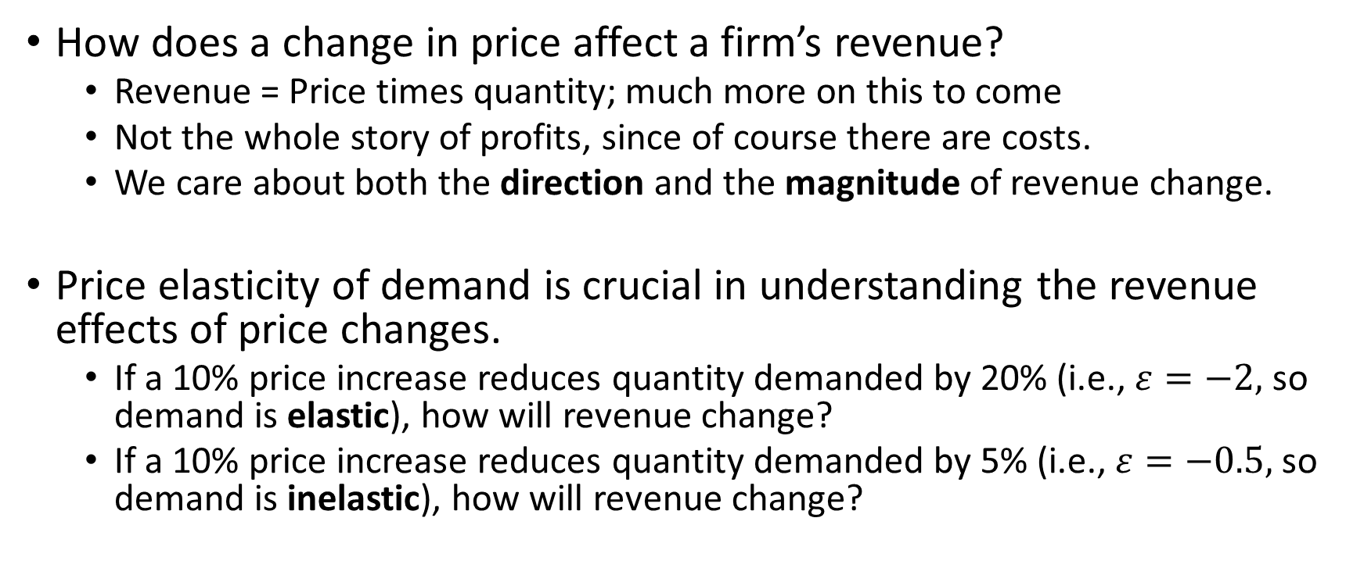
Price elasticity and revenue
How does a change in price affect a firm’s revenue?
Revenue = Price times quantity; much more on this to come
Not the whole story of profits, since of course there are costs.
We care about both the direction and the magnitude of revenue change.
Price elasticity of demand is crucial in understanding the revenue effects of price changes.
If a 10% price increase reduces quantity demanded by 20% (i.e., $ε=−2,$ so demand is elastic), how will revenue change?
If a 10% price increase reduces quantity demanded by 5% (i.e., $ε=−0.5,$ so demand is inelastic), how will revenue change?
Notes:
1.1p * 0.8q = 0.88 pq < pq
1.1p * 0.95q = 1.045 pq > pq

Slide 23
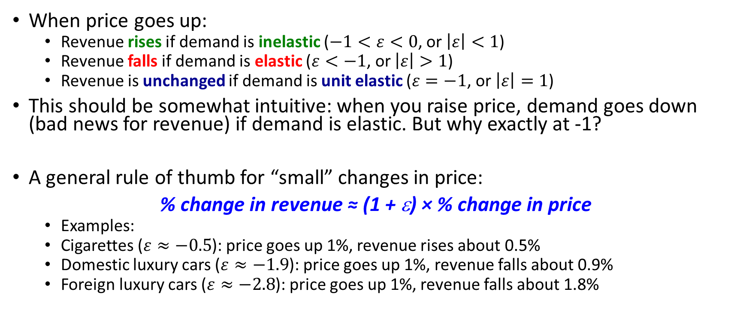
Price elasticity and revenue
When price goes up:
Revenue rises if demand is inelastic ($−1<ε<0$, or $\left|ε\right|<1$)
Revenue falls if demand is elastic ($ε<−1$, or $\left|ε\right|>1$)
Revenue is unchanged if demand is unit elastic ($ε=−1$, or $\left|ε\right|=1$)
This should be somewhat intuitive: when you raise price, demand goes down (bad news for revenue) if demand is elastic. But why exactly at -1?
A general rule of thumb for “small” changes in price:
% change in revenue ≈ (1 + ε) × % change in price
Examples:
Cigarettes ($ε≈−0.5$): price goes up 1%, revenue rises about 0.5%
Domestic luxury cars ($ε≈−1.9$): price goes up 1%, revenue falls about 0.9%
Foreign luxury cars ($ε≈−2.8$): price goes up 1%, revenue falls about 1.8%
Notes:
🔹 Key idea: Total Revenue (TR) = Price (P) × Quantity (Q)
When price changes, two forces work in opposite directions:
Price effect: Higher price tends to increase TR.
Quantity effect: Higher price reduces Q, which tends to decrease TR.
Elasticity tells us which effect dominates.
1️⃣ Elastic region (|E| > 1) → Consumers are very responsive
If price ↑ (rises slightly): Quantity demanded falls more than proportionately. → The quantity effect dominates, so TR decreases. 💡 Example: Coffee lovers easily switch to tea when price rises.
If price ↓ (falls slightly): Quantity demanded increases more than proportionately. → The quantity effect dominates again, but in the positive direction — TR increases. 💡 Firms sell much more, and total earnings rise.
2️⃣ Inelastic region (|E| < 1) → Consumers are not very responsive
If price ↑ (rises slightly): Quantity demanded falls less than proportionately. → The price effect dominates, so TR increases. 💡 Think: Gasoline — price up, but people still buy it.
If price ↓ (falls slightly): Quantity demanded rises less than proportionately. → The price effect dominates, so TR decreases. 💡 You cut price, but people don’t buy that much more.
⚡ Quick Summary Table
Elasticity TypeWhen Price ↑When Price ↓Elastic (>1)TR ↓TR ↑Inelastic (<1)TR ↑TR ↓Unit Elastic (=1)TR stays sameTR stays same
My opinion: Think of elasticity as a “sensitivity dial.” When demand is elastic, customers react a lot — so price changes backfire easily. When inelastic, they barely react — so firms can raise prices without much revenue loss.

Slide 24
Elasticity rules of thumb
Rule of thumb 1: Luxuries vs. necessities
Elasticity is higher (in absolute value) for luxuries.
Rule of thumb 2: Short-run vs. long-run
Elasticity is lower (in absolute value) in the short run than in the long run. (Also true for supply)
Rule of thumb 3: Brand vs. category (availability of substitutes)
Elasticity is higher (in absolute value) for specific products than for a category as a whole.

Slide 25
Some examples
Good/Service Elasticity
Air travel (leisure) -1.52
Air travel (business) -1.15
Tobacco (short run) -0.46
Tobacco (long run) -1.89
Beer (overall) -1.30
Beer (Budweiser) -4.19
Beer (Milwaukee’s Best) -6.21
Gasoline (short run) -0.20
Gasoline (long run) -0.60
Luxury autos (domestic) -1.90
Luxury autos (foreign) -2.80
Notes:
http://youtu.be/COf2bQEQ7Zw

Slide 26
Summary: price elasticity of demand
Describes price sensitivity in terms of percent changes in quantity for percent change in price
Is related to slope but is not the slope
Is much MORE useful than slope when choosing price/quantity to maximize profits
It is not specific to a particular unit of measure

Slide 27
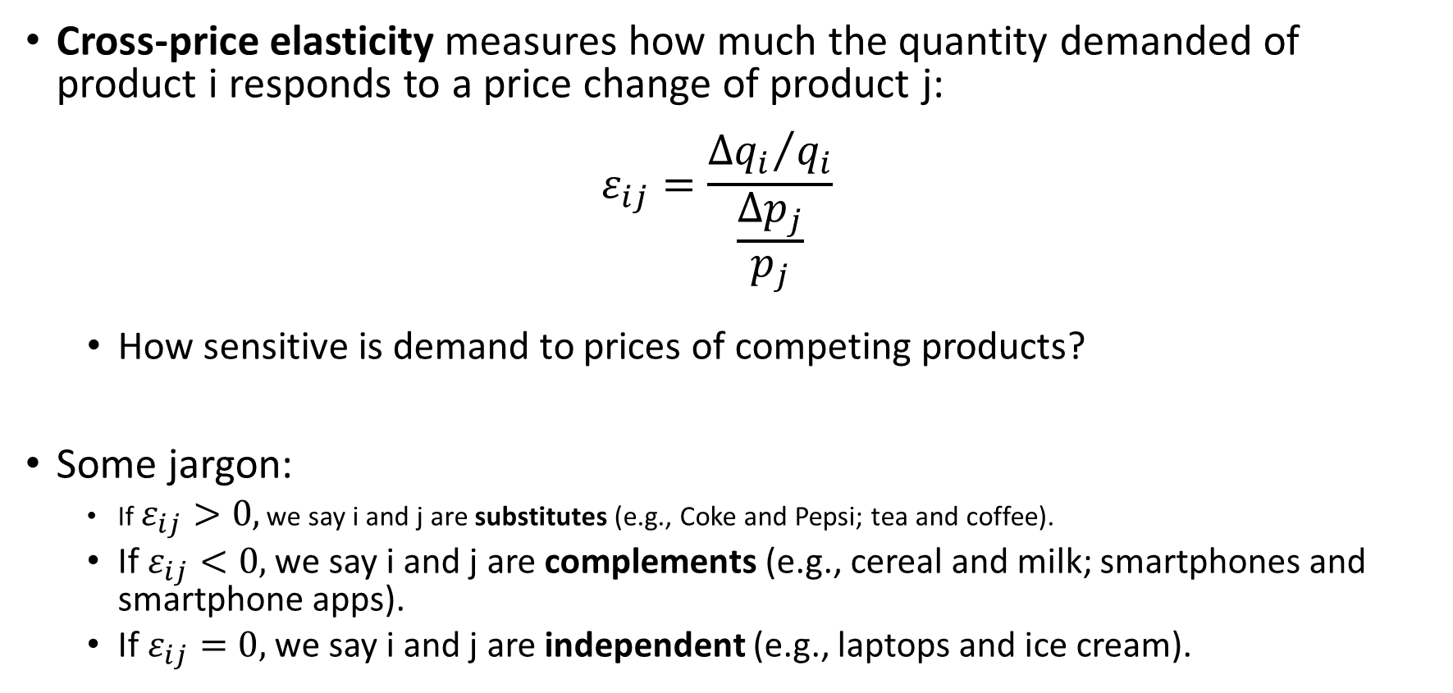
Cross-price elasticity of demand
Cross-price elasticity measures how much the quantity demanded of product i responds to a price change of product j: $ε_{ij}=\frac{{Δq_{i}}/{q_{i}}}{\frac{Δp_{j}}{p_{j}}}$
How sensitive is demand to prices of competing products?
Some jargon:
If $ε_{ij}>0,$ we say i and j are substitutes (e.g., Coke and Pepsi; tea and coffee).
If $ε_{ij}<0,$ we say i and j are complements (e.g., cereal and milk; smartphones and smartphone apps).
If $ε_{ij}=0,$ we say i and j are independent (e.g., laptops and ice cream).

Slide 28
Cross-price elasticity
Price elasticities (price in column)
 | Civic | Camry | LS | 7-series
Honda Civic | -6.528 | 0.078 | 0.000 | 0.000
Toyota Camry | 0.054 | -6.031 | 0.001 | 0.000
Lexus LS | 0.000 | 0.000 | -3.085 | 0.093
BMW 7-series | 0.000 | 0.001 | 0.032 | -3.515
Why are the “own-price” elasticities so high?
Are the Civic and Camry complements or substitutes? What about the Civic and the 7-series?
If BMW raises the price of the 7-series, what happens to sales of the Lexus? And vice versa?

Slide 29
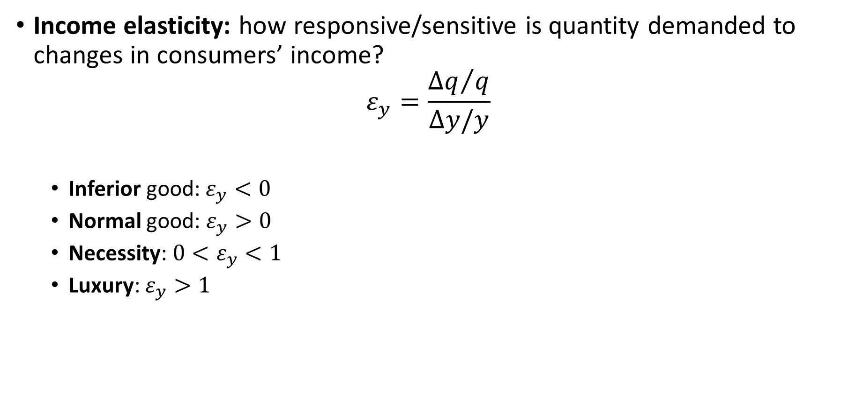
Income elasticity of demand
Income elasticity: how responsive/sensitive is quantity demanded to changes in consumers’ income?
$$ε_{y}=\frac{{Δq}/q}{Δy/y}$$
Inferior good: $ε_{y}<0$
Normal good: $ε_{y}>0$
Necessity: ${0<ε}_{y}<1$
Luxury: $ε_{y}>1$

Slide 30
Summary: Demand elasticities
The demand function for a good depends on (at a minimum) its own price, the prices of related products, and consumer income
Own price change: move along the demand curve
Other factors change: shift in the demand curve
Price elasticity of demand measures the responsiveness of quantity demanded to a price change. Useful for predicting impact of price changes on quantity.
Revenue rises/falls with price if demand is inelastic/elastic.
Other useful elasticity concepts: cross-price and income elasticity.

